Slide 1


AI VTubers: Your Next 24/7 Star
Intelligences.Systems
2025/05/01

Slide 2







Vision & Product
Business Model
Market Proof
Tech Edge
Validation
Future & Ask

Slide 3
CHAPTER.01
Vision & Product

Slide 4

AI VTubers with Soul, Live 24/7
We create fully autonomous anime-style streamers that play games, banter with chat, and sing. We evolve from a co-host SaaS to a personal entertainer platform, unlocking a multi-billion-dollar market at the intersection of VTubing, gaming, and AI companionship.

Slide 5
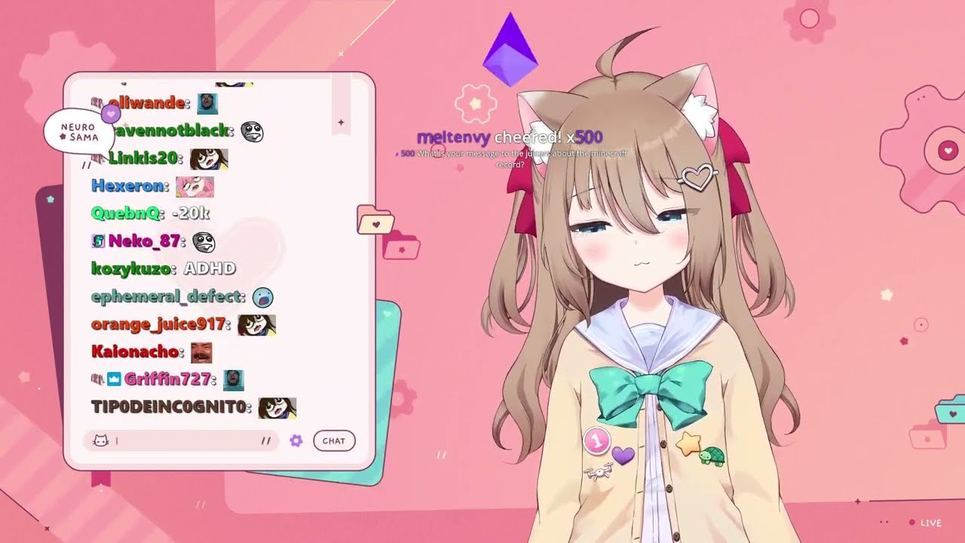
Interactive Demo in One Year
Our year-one product is an AI co-host plugin: a cute avatar overlay that reads chat, cracks jokes, celebrates subs, and plays mini-games. This helps mid-tier creators boost retention and tips.
We charge a monthly SaaS fee or take a revenue share, creating an early revenue stream.
Most importantly, we collect live engagement data to train our models, proving stickiness before launching solo AI stars.

Slide 6
CHAPTER.02
Market Proof

Slide 7
Japan VTuber Market: A Proven Powerhouse
The home of VTubing generates hundreds of millions with a diversified model.
Merchandise: 47%
Live Events: 21%
¥43.4B
¥20.5B from goods, cards, etc.
Sold-out Budokan concerts
Cover Corp Revenue
+44% YoY Growth
Licensing: 13%
Content: 19%
IP collaborations
Streaming revenue

Slide 8
Global Viewership is Accelerating
VTubers punch far above their weight, capturing a massive share of watch time.
1.4%
9.6%
+28%
→
→
of Gaming Channels
of Watch Hours
Growth in 2023
(YouTube)
(Disproportionate Share)
(While others fell -6%)
Stars like Gawr Gura (4.5M subs) and Ironmouse signal strong Western appetite.

Slide 9
CHAPTER.03
Validation

Slide 10
Case Study: Neuro-sama
From zero to #1 female streamer on Twitch in one year.
Developed by a single programmer, this AI VTuber proved the model's viability, generating massive audience engagement and revenue.
480K
142K
Twitch Followers
Active Subscribers
45K
~$500K
Peak Viewers
MRR Potential

Slide 11
AI vs. Human: A New Competitive Landscape
Neuro-sama's metrics place her among the top tier of human streamers.
Neuro-sama (AI)
Mid-Tier Human VTuber
142k Active Subs (8th All-Time)
5-15k Active Subs
6-11k Average CCV
5-10k Average CCV
24/7 Streaming Capability
4-8 hours Stream Limit
~$25k/mo per 10k subs
~$25k/mo per 10k subs

Slide 12
CHAPTER.04
Business Model

Slide 13
Our Three-Phase Road to a Billion-Dollar Valuation
1
2
3
Phase 1: SaaS Co-Host
Phase 2: AI Talent Agency
Phase 3: Personal AI Platform
B2B2C model to fund data collection and prove engagement.
Monetize via subs, merch, and events like Hololive's ¥20.5B model.
Subscription service for bespoke AI companions at $10-30/month.

Slide 14
AI Economics: A Superior Business Model
Lower marginal costs and higher scalability unlock superior margins.
Human Talent Agency
AI VTuber Agency
Salaries, travel, insurance
Low marginal compute cost
Graduation & scandal risk
No graduation or fatigue
Physical & time limitations
24/7 streaming capability
High overhead costs
Instant global scalability
Net Margin: ~27%
Projected Net Margin: 40%+

Slide 15
CHAPTER.05
Tech Edge

Slide 16
Our End-to-End AI Pipeline: An Irreplicable Moat
→
→
→
1. Pre-trained LLM
2. Post-Training
3. Game Agent
4. TTS & Emotion
Witty dialogue foundation.
Optimized for engagement.
RL for autonomous play.
Real-time singing & reactions.
Continuous guardrail filtering ensures safety and compliance, creating a robust, irreplicable technological lead.

Slide 17
The Data Flywheel & IP Vault
Every interaction fuels our competitive advantage. A virtuous cycle of improvement and monetization.
Data Flywheel
Live engagement data continuously refines our AI's joke timing, donation prompts, and game strategy.
IP Vault
Character designs, lore, and voice banks become reusable, monetizable IP for future platform subscribers.

Slide 18
CHAPTER.06
Future & Ask

Slide 19
The Future: A Personal Entertainer for Every Gamer
From a one-to-many agency to a one-to-one platform, unlocking massive LTV.
$240M
→
→
Annual Recurring Revenue
1 Million Subscribers
Core Subscription
Billions in LTV
At $20/month
From merch, DLC, social features

Slide 20
Investment Ask & Use of Funds
Use of Funds Breakdown
$6 Million Seed Round
AI Compute
40%
For an 18-month runway to achieve critical milestones and set the stage for a Series A.
Engineering
25%
Character & IP
20%
Key Milestones (12 Months):
Marketing
10%
200+ paying streamer clients for AI co-host.
3 autonomous AI talents, each averaging 5k+ subs.
Repeatable and profitable merch drops.
Legal & Safety
5%

Slide 21



